Slide 1
Security Access(0x27)
Presented By
Rubihaa janani

Slide 2
Security Access:
UDS is designed to allow up to security levels that are, in the end, boolean flags set in the server.
These security levels, as well as what they unlock, are not defined by UDS but will be by the ECU manufacturer.
A security level can unlock a whole service, a subfunction or the access to a specific value.

Slide 3
Why Security Access:
To restrict the accessing of data such as-emission related data,downloading/uploading or using rountines server or reading/writing confidential information.

Slide 4
Seed and Key:
Seed:Tester should request seed to the ECU,ECU can give seed as response if the request is correct else it should throw Negative Response Code(NRC)
Key:Tester will take key from the seed and send the particular key then ECU will unlock&send positive response.

Slide 5
Security Access Flow Sequence:
Client request for the seed.
Server responds with seed.
Client request for the key (respective for the seed received)
Server responds that the key was valid and that it will unlock itself.

Slide 6
Request Security Access:
To request Security Access, the tester will first send a command to request a random seed from the ECU (i.e. 0x27 01).
If the ECU will allow this in their current state, it may respond with a positive response including the seed (i.e. 0x67 01 AA BB CC DD).
Then the tester application needs to take this seed (0xAA BB CC DD) and apply a secret key generation algorithm to it.
i.e. a cryptographic function using a private key only known to ECU and authorized tester - once the key is calculated it needs to be sent back to the ECU (i.e. 0x27 02 66 77 88 99).
The ECU can reply to this with a positive response (i.e. 0x67 02) or an Negative Response Code (i.e. 0x7F 0x27 0x35).

Slide 7
Encryption :
Encryption is the method by which information is converted into secret code that hides the information.
The science of encrypting and decrypting information is called cryptography.

Slide 8
decryption
Decryption is the process of converting an encrypted message back to its original (readable) format.
The original message is called the plaintext message.

Slide 9
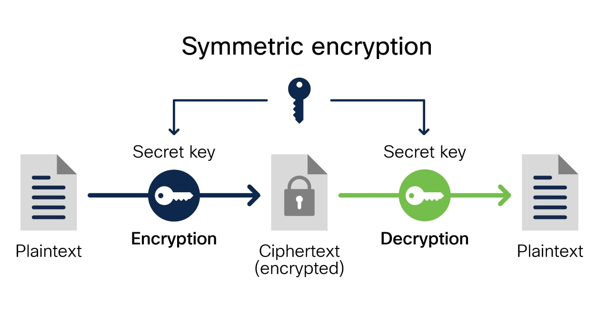
Symmetric encryption:

Slide 10
THANK YOU ☺

